Slide 1

KrishiSalah: AI-Powered Precision Crop Recommendation System

Slide 2




The Challenge: Farming's Traditional Gamble
Farmers often rely on inherited knowledge or past market trends, leading to suboptimal crop choices and significant challenges.
Unpredictable Climate
Soil Degradation
Changing weather patterns and irregular monsoons impact yields.
Lack of insights into specific soil nutrient deficiencies.
Market Volatility
Resource Inefficiency
Oversupply of crops can lead to low market prices.
Overuse of water, fertilizers, and pesticides raises costs and harm.
These issues lead to reduced yields, financial losses, increased farmer debt, and unsustainable agricultural practices.

Slide 3
Introducing KrishiSalah: Data-Driven Decisions
KrishiSalah is a user-friendly mobile and web application that leverages AI and ML to transform farming. We analyze unique field data to recommend the most suitable, profitable, and sustainable crop for every season.

Slide 4
Our Differentiators: Beyond Basic Recommendations
Data Input
Basic soil type or location; manual, generic data.
Multi-source integration: Soil health, real-time weather, satellite imagery, local market prices.
Analysis Method
Rule-based systems or static information.
Predictive AI/ML Models: Algorithms find complex patterns and predict outcomes.
Recommendation
Generic, one-size-fits-all advice.
Hyper-personalized: Precise, plot-specific recommendations with confidence scores.
Additional Insights
Limited to crop name.
Actionable insights: Expected yield, fertilizer needs, ideal sowing time, risk alerts.
Accessibility
Desktop-based or requires expert consultation.
Mobile-first, Vernacular Support: Accessible via smartphones in local languages.

Slide 5



How It Works: The Tech Behind KrishiSalah
Our robust technical architecture ensures accurate, timely, and accessible recommendations.
1. Data Acquisition Layer
2. AI/ML Engine (Core)
3. Application Layer
Collects user input (GPS, soil reports via image) and integrates data from APIs (weather, FAO soil) and historical databases.
Cleans data, trains a Random Forest Classifier model on historical parameters (N-P-K, rainfall, pH, temp), and predicts optimal crops.
Web portal with voice and vernacular support, delivering clear recommendations.

Slide 6
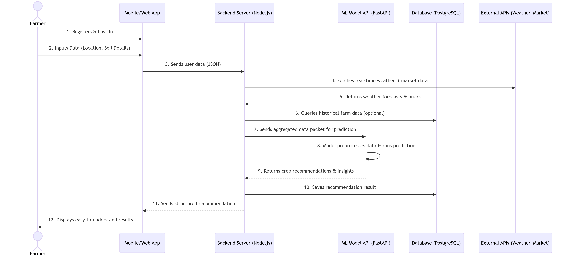

Architecture/Work Flow
Phase 1: Input Data
Farmer registers and logs in
Adds field location on a map
Enters soil details manually or by scanning soil health card
Phase 2: Gather Information
System automatically collects weather data
Fetches current market prices
Compiles all relevant information
Phase 3: AI Processing
AI analyzes soil, weather and market data
Calculates best crop matches
Generates personalized recommendations
Phase 4: Receive Results
Farmer gets clear crop suggestions
Shows brief reasons for each recommendation
Provides simple next steps to follow

Slide 7
Impact & Benefits: A Win-Win for All
For Farmers
For Society & Environment
Increased Yield & Income: Data-driven choices lead to more successful harvests.
Food Security: Increased overall agricultural productivity.
Reduced Costs: Optimized use of water, fertilizers, and pesticides.
Sustainable Farming: Promotes resource conservation and soil health.
Risk Reduction: Alerts for droughts, pests, or price crashes.
Economic Growth: Stabilizes farmer incomes and boosts the agricultural economy.
Empowerment: Access to expert knowledge on their mobile phones.

Slide 8

The Future of Farming is Here.
KrishiSalah is a revolutionary AI-powered platform that is redefining the future of agriculture. By leveraging cutting-edge technology and data-driven insights, KrishiSalah is empowering farmers to make informed decisions and optimize their crop yields like never before.
Precision Farming
Sustainable Solutions
KrishiSalah utilizes advanced sensors, satellite imagery, and predictive analytics to provide hyper-localized recommendations tailored to each individual farm's unique conditions.
KrishiSalah's recommendations prioritize sustainable practices, promoting efficient resource utilization and minimizing the environmental impact of modern agriculture.
Data-Driven Decisions
By analyzing vast amounts of agricultural data, KrishiSalah helps farmers make data-driven decisions, reducing the traditional guesswork and uncertainty inherent in farming.
1
Increased Yields
2
Optimized Resource Allocation
3
Reduced Risk and Uncertainty
4
Sustainable Farming Practices

Slide 9
Project Link: link: https://github.com/sbharathkrishnan28/AI-Based-Crop-Recommendation-for-Farmers.git
TEAM DETAILS TEAM NAME: SyntheGreen TEAM MEMBERS:
NAME | PHONE NO | COLLEGE
Bharath Krishnan S | 8754716433 | Chennai Institute Of Technology
Asvitha B | 7845114664 | Chennai Institute Of Technology
Aloysius Geneva R F | 6352624172 | Chennai Institute Of Technology

Slide 10
Key Takeaways & Next Steps
AI-Powered Precision: KrishiSalah offers hyper-localized crop recommendations, moving beyond traditional methods.
Comprehensive Data Integration: Our system synthesizes diverse data points for accurate, actionable insights.
Tangible Impact: We increase farmer profitability, reduce environmental harm, and enhance food security.
Join us in cultivating a more prosperous and sustainable future for agriculture.

